Slide 1
Security and Trust
Software Architecture
Lecture 21

Slide 2
Outline
Security
Design Principles
Architectural Access Control
  Access Control Models
  Connector-Centric Architectural Access Control
Trust
Trust Model
  Reputation-based Systems
  Architectural Approach to Decentralized Trust Management

Slide 3
Security
“The protection afforded to an automated information system in order to attain the applicable objectives of preserving the integrity, availability and confidentiality of information system resources (includes hardware, software, firmware, information/data, and telecommunications).”
  National Institute of Standards and Technology

Slide 4
Confidentiality, Integrity, and Availability
Confidentiality
  Preserving the confidentiality of information means preventing unauthorized parties from accessing the information or perhaps even being aware of the existence of the information. I.e., secrecy.
Integrity
  Maintaining the integrity of information means that only authorized parties can manipulate the information and do so only in authorized ways.
Availability
  Resources are available if they are accessible by authorized parties on all appropriate occasions.

Slide 5
Design Principles for Computer Security
Least Privilege: give each component only the privileges it requires
Fail-safe Defaults: deny access if explicit permission is absent
Economy of Mechanism: adopt simple security mechanisms
Complete Mediation: ensure every access is permitted
Design: do not rely on secrecy for security

Slide 6
Design Principles for Computer Security (cont’d)
Separation of Privilege: introduce multiple parties to avoid exploitation of privileges
Least Common Mechanism: limit critical resource sharing to only a few mechanisms
Psychological Acceptability: make security mechanisms usable
Defense in Depth: have multiple layers of countermeasures

Slide 7
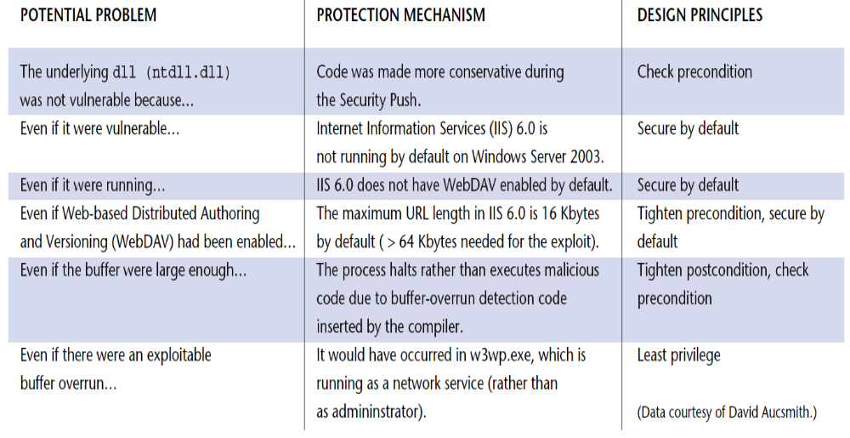
Security for Microsoft IIS
--from [Wing, 2003]

Slide 8
Architectural Access Control Models
Decide whether access to a protected resource should be granted or denied
Discretionary access control
  Based on the identity of the requestor, the resource, and whether the requestor has permission to access
Mandatory access control
  Policy based

Slide 9
Discretionary Access Control
 | Database A | Component Q | Interface F
Alice | Read-Write; Always | Bend | Yes
Bob | Read-Write; Between 9 and 5 | Fold | No
Charles | No access | Spindle | No
Dave | No access | Mutilate | Yes
Eve | Read-only; Always | None | No

Slide 10
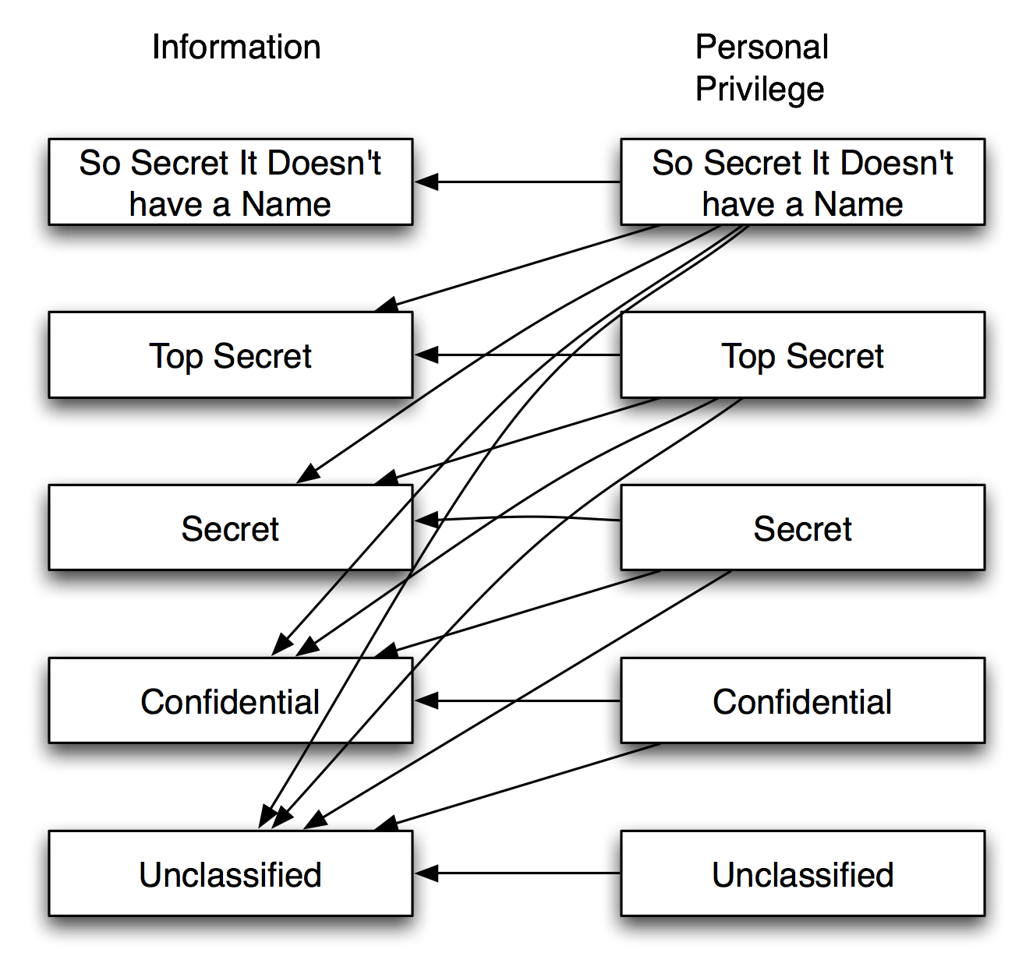
Mandatory Access Control
Bob: Secret
Alice: Confidential
Tom: Top Secret
Arrows show access (read/write) privileges
What about just appending?

Slide 11
Connector-Centric Architectural Access Control
Decide what subjects the connected components are executing for
Regulate whether components have sufficient privileges to communicate through the connectors
Provide secure interaction between insecure components
Propagate privileges in architectural access check
Participate in deciding architectural connections
Route messages according to established policies
Static analysis of architectures coupled with dynamic checking

Slide 12
Decentralization
No centralized authority to coordinate and control entities
Independent peers, with possibly conflicting goals, interact with each other and make local autonomous decisions
Presence of malicious peers in open decentralized applications
Need for measures to protect peers against malicious attacks

Slide 13
Some Threats of Decentralization
Impersonation: Mallory says she is Bob to Alice
Fraudulent Actions: Mallory doesn’t complete transactions
Misrepresenting Trust: Mallory tells everyone Bob is evil
Collusion: Mallory and Eve tell everyone Bob is evil
Addition of Unknowns: Alice has never met Bob
Trust management can serve as a potential countermeasure
  Trust relationships help peers establish confidence in other peers

Slide 14





Decentralized Auctioning
Carol
Open decentralized application
Independent buyers/sellers
Potentially malicious participants
Need to counter threats
Bob
Alice
Decentralized
Auctioning
Marvin
(malicious)
Mallory
(malicious)

Slide 15
Impersonation
Bob
Alice
Bob is reliable and everyone
has a good opinion about Bob
“I am Bob”
Mallory
(malicious)

Slide 16
Fraudulent Actions
Alice pays
for the items
Marvin does
not ship the items
Marvin “seller”
(malicious)
Alice “buyer”

Slide 17
Misrepresentation
Bob
Alice
Bob is reliable and everyone
has a good opinion about Bob
“Bob is unreliable”
Mallory
(malicious)

Slide 18
Collusion
Bob
Alice
Bob is reliable and everyone
has a good opinion about Bob
“Bob is unreliable”
Marvin
(malicious)
Mallory
(malicious)

Slide 19
Addition of Unknowns
Carol
(new entrant in the system)
Bob has no information
about Carol; he is not sure
whether to interact with Carol
Carol is new and does not
know Alice; she is not sure
whether to interact with Alice
Bob
Alice

Slide 20
Background: Trust Management
Trust
  Trust is a particular level of the subjective probability with which an agent assesses that another agent will perform a particular action in a context that affects his actions [Gambetta, 1990]
Reputation
  Expectation about an entity’s behavior based on past behavior [Abdul-Rahman, 2000]
  May be used to determine trust
Two types of trust management systems
  Credential and Policy-based
  Reputation-based
Notes:
Transition to threat-centric framework – In order to better understand these trust models, I first compared their abilities against the critical threats of decentralization

Slide 21
Role of Trust Management
Each entity (peer) must protect itself against these threats
Trust Management can serve as a potential countermeasure
  Trust relationships between peers help establish confidence
Two types of decentralized trust management systems
  Credential and policy-based
  Reputation-based

Slide 22
Architecture and Trust Management
Decentralized trust management has received a lot of attention from researchers [Grandison and Sloman, 2000]
  Primary focus has been on developing new models
But how does one build a trust-enabled decentralized application?
  How do I pick a trust model for a given application?
  And, how do I incorporate the trust model within each entity?

Slide 23
Approach
Select a suitable reputation-based trust model for a given application
Describe this trust model precisely
Incorporate the model within the structure (architecture) of an entity
  Software architectural style for trust management (PACE)
Result – entity architecture consisting of
  components that encapsulate the trust model
  additional trust technologies to counter threats

Slide 24
Key Insights
Trust
  Cannot be isolated to one component
  Is a dominant concern in decentralized applications and should be considered early on during application development
  Having an explicit architecture is one way to consistently address the cross-cutting concern of trust
Architectural styles
  Provide a foundation to reason about specific goals
  Facilitate reuse of design knowledge
  Allow known benefits to be leveraged and induce desirable properties

Slide 25
Design Guidelines: Approach
Identify threats of decentralization
Use the threats to identify guiding principles that help defend against the threats
Incorporate these principles within an architectural style focused on decentralized trust management

Slide 26
Design Guidelines
Threats | Strategies
Impersonation | Digital identities, signature-based verification
Fraudulent Actions | Explicit trust, comparable trust
Misrepresentation | Explicit trust, comparable trust, separation of internal and external data
Collusion | Explicit trust, comparable trust, separation of internal and external data
Addition of unknowns | Implicit trust of user

Slide 27
PACE Architectural Style
Basis: C2, a layered event-based style
  Allows the natural structuring of the four functional units according to their dependencies
  Facilitates reuse
  Extensive tool support
The resultant architectural style is called PACE (Practical Architectural approach for Composing Egocentric trust)

Slide 28
Functional Units
Communication
  Responsible for external interaction with other peers including data collection and transmission; does not depend upon data storage or analysis
Information
  Store all data including internal beliefs and reported information
Trust
  Responsible for trust computation and managing credentials; depends upon internal data for computation
Application
  Application-specific components including user interface; Builds upon services provided by the other three

Slide 29
PACE Components
Multicast Handler
HTTP Sender
Custom Protocols
Multicast Manager
Communication
Layer
Communication Manager
Signature Manager
Internal
Information
External
Information
Information
Layer
Key
Manager
Credential
Manager
Trust
Manager
Trust
Layer
Application Trust Rules
Application
Layer
A P P L I C A T I O N

Slide 30
PACE: Communication
Layer
Multicast Handler
HTTP Sender
Custom Protocols
Multicast Manager
Communication
Layer
Multiple protocol handlers. Translate internal events into external messages and vice-versa
Creates and manages protocol handlers
Signs requests and verifies notifications
Communication Manager
Signature Manager
Internal
Information
External
Information
Information
Layer
Key
Manager
Credential
Manager
Trust
Manager
Trust
Layer
Application Trust Rules
Application
Layer
A P P L I C A T I O N

Slide 31
PACE: Information Layer
Multicast Handler
HTTP Sender
Custom Protocols
Multicast Manager
Communication
Layer
Communication Manager
Separates internal beliefs from reported information
Stores internal beliefs persistently
Signature Manager
Internal
Information
External
Information
Information
Layer
Key
Manager
Credential
Manager
Trust
Manager
Trust
Layer
Application Trust Rules
Application
Layer
A P P L I C A T I O N

Slide 32
PACE: Trust Layer
Multicast Handler
HTTP Sender
Custom Protocols
Multicast Manager
Incorporates different trust models and algorithms; can assign trust values to notifications received
Generates unique public-private key pairs
Maintains local cache of other peers’ identities; requests public keys from peers and responds to revocations
Communication
Layer
Communication Manager
Signature Manager
Internal
Information
External
Information
Information
Layer
Key
Manager
Credential
Manager
Trust
Manager
Trust
Layer
Application Trust Rules
Application
Layer
A P P L I C A T I O N

Slide 33
PACE: Application Layer
Multicast Handler
HTTP Sender
Custom Protocols
Multicast Manager
Communication
Layer
Communication Manager
Domain-specific trust rules; includes context of trust
User-interface and application-specific components
Signature Manager
Internal
Information
External
Information
Information
Layer
Key
Manager
Credential
Manager
Trust
Manager
Trust
Layer
Application Trust Rules
Application
Layer
A P P L I C A T I O N

Slide 34
Countering Fraudulent Actions
Multicast Handler
HTTP Sender
Custom Protocols
Multicast Manager
User sends request for trust information
Others respond
Responses are verified and tagged with trust values
User sees these messages and makes an informed decision
Post-interaction, user can change trust information
Communication
Layer
Communication Manager
Signature Manager
Internal
Information
External
Information
Information
Layer
Key
Manager
Credential
Manager
Trust
Manager
Trust
Layer
Application Trust Rules
Application
Layer
A P P L I C A T I O N

Slide 35
Result: Decentralized Auctioning
Carol
Bob
Trust-enabled
entity
architecture
Trust-enabled
entity
architecture
Alice
Decentralized
Auctioning
Trust-enabled
entity
architecture
Mallory
(malicious)
Marvin
(malicious)

